Slide 1
Machine Learning: Supervised & Unsupervised Learning
Brian Grey, Chad Chu

Slide 2
Table of Contents
Machine Learning Vs. Artificial Intelligence
Supervised vs. Unsupervised Learning
Classification
Naïve Bayes Classifier (Supervised)
Decision Trees (Supervised)
K-Means Clustering (Unsupervised)
Are there other techniques?

Slide 3
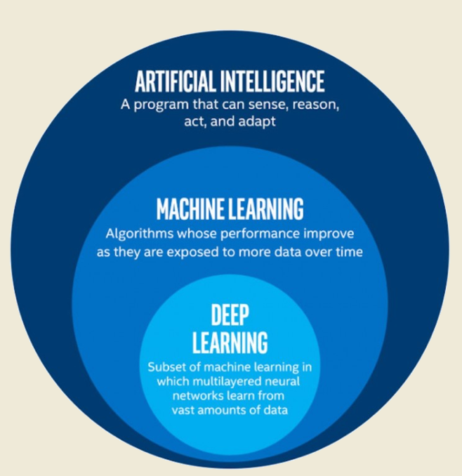
Machine Learning Vs. Artificial Intelligence
Artificial Intelligence is the broader concept of machines being able to carry out tasks in a way that we would consider “smart”.
We are moving toward a focus of machine learning, where we give an algorithm more and more data so that it can make improvements on its behavior given that it will constantly being taking in more inputs.

Slide 4
Classification Algorithms Supervised Vs. Unsupervised Learning
Classification algorithms are techniques to organize data into some category or class.
There are two main types:
Supervised: training of the algorithm is done by labeled (known) data, which is then used on real world data.
Unsupervised: self-organized Hebbian learning that helps find previously unknown patterns in a data set without pre-existing labels.
So the problem becomes, how do we make an algorithm learn from new data given that it knows some data already?
We can model this problem the same way humans learn.
Two scenarios:
You are experiencing something that you have experienced in the past.
You are experiencing something completely new.

Slide 5
Common Supervised Learning Algorithms
Decision trees
Random forest
k-NN
Naive Bayes
Artificial neural networks
Logistic regression
Perceptron

Slide 6
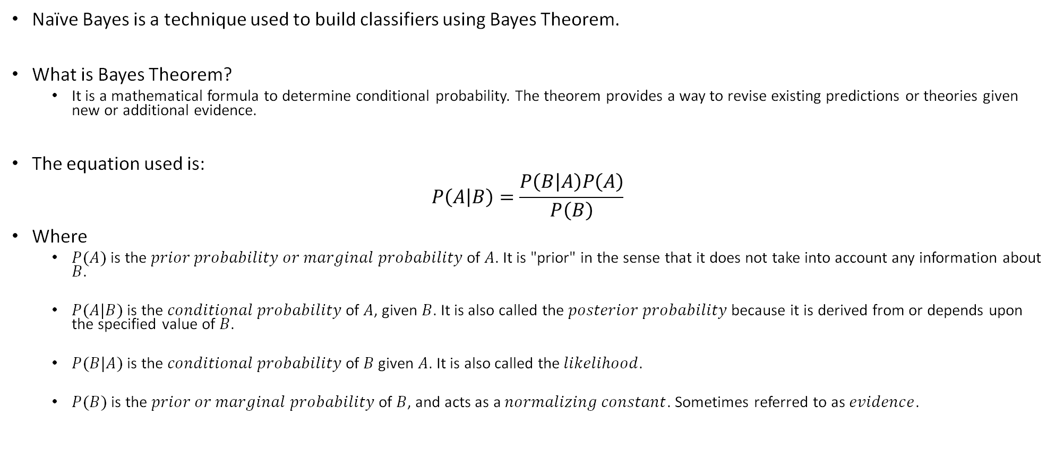
Naïve Bayes Classifier
Naïve Bayes is a technique used to build classifiers using Bayes Theorem.
What is Bayes Theorem?
It is a mathematical formula to determine conditional probability. The theorem provides a way to revise existing predictions or theories given new or additional evidence.
The equation used is:
$$P\left(A | B\right)=\frac{P\left(B | A\right)P\left(A\right)}{P\left(B\right)}$$
Where
$P(A)$ is the $prior probability or marginal probability$of $A$. It is "prior" in the sense that it does not take into account any information about $B$.
$P(A|B)$ is the $conditional probability$of $A$, given $B$. It is also called the $posterior probability$because it is derived from or depends upon the specified value of $B$.
$P(B|A)$ is the $conditional probability$of $B$ given $A$. It is also called the$likelihood$.
$P(B)$ is the $prior or marginal probability$of $B$, and acts as a $normalizing constant$. Sometimes referred to as $evidence$.

Slide 7
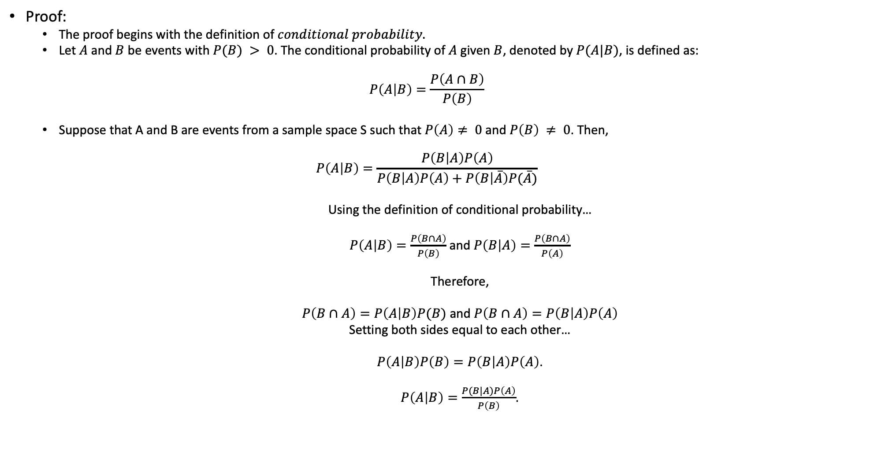
Bayes Theorem Proof
Proof:
The proof begins with the definition of $conditional probability.$
Let $A$ and $B$ be events with $P(B) > 0$. The conditional probability of $A$ given $B$, denoted by $P(A|B)$, is defined as:
$$P\left(A | B\right)=\frac{P\left(A∩B\right)}{P\left(B\right)}$$
Suppose that A and B are events from a sample space S such that $P\left(A\right)≠ 0$ and $P\left(B\right) ≠ 0$. Then,
$$P\left(A | B\right)=\frac{P\left(B | A\right)P\left(A\right)}{P\left(B | A\right)P\left(A\right)+P\left(B | \overline{A}\right)P(\overline{A})}$$
Using the definition of conditional probability…
$P\left(A | B\right)=\frac{P\left(B∩A\right)}{P\left(B\right)}$ and $P\left(B | A\right)=\frac{P\left(B∩A\right)}{P\left(A\right)}$
Therefore,
$P\left(B∩A\right)=P\left(A | B\right)P(B)$ and $P\left(B∩A\right)=P\left(B | A\right)P\left(A\right)$
Setting both sides equal to each other…
$P\left(A | B\right)P\left(B\right)=P\left(B | A\right)P\left(A\right)$.
$P\left(A | B\right)=\frac{P(B|A)P\left(A\right)}{P\left(B\right)}$.

Slide 8
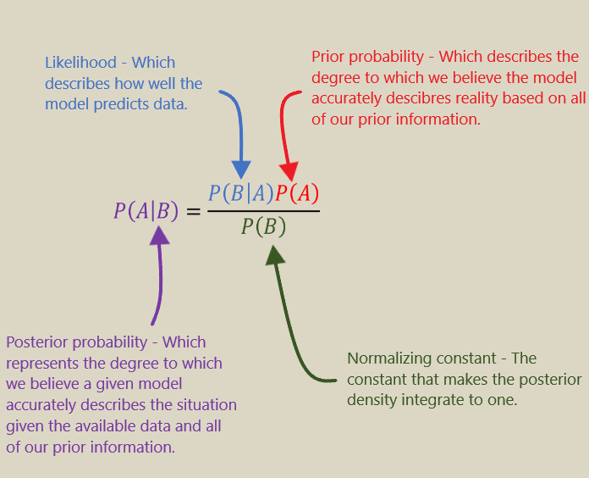

Bayes Theorem
$$≡P\left(B | A\right)P\left(A\right)+P\left(B | \overline{A}\right)P(\overline{A})$$
Notes:
Check posterior probablilty

Slide 9
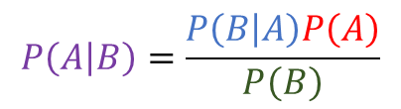
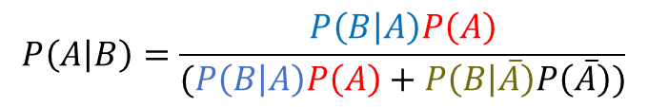
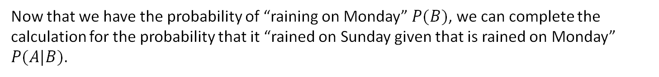




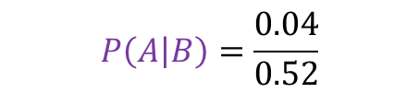
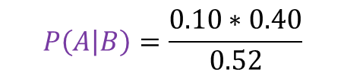
Bayes Theorem Example
A simple example is as follows: There is a $40\%$chance of it raining on Sunday. If it rains on Sunday, there is a $10\%$chance it will rain on Monday. If it didn’t rain on Sunday, there's an $80\%$chance it will rain on Monday. What is the probability that is will rain on Sunday given that it will rain on Monday?
“Raining on Sunday” is event $A$, and “Raining on Monday” is event $B$.
$P\left(A\right)=0.40$
$P\left(\overline{A}\right)=0.60$
$P\left(B|A\right)=0.10$
$P\left(\overline{B} | A\right)=0.90$
$P\left(B | \overline{A}\right)=0.80$
$P\left(\overline{B} | \overline{A}\right)=0.20$
$P\left(B\right)=0.52$
$P\left(A | B\right)=0.0769$
The first thing we would like to calculate is $P(B)$
$$P\left(A | B\right)=\frac{P\left(B | A\right)P\left(A\right)}{(P\left(B | A\right)P\left(A\right)+P\left(B | \overline{A}\right)P\left(\overline{A}\right))}$$
$$=P(B)$$
$0.10 ∗0.40+0.80 ∗0.60=0.52=52\%$
Now that we have the probability of “raining on Monday” $P(B)$, we can complete the calculation for the probability that it “rained on Sunday given that is rained on Monday” $P(A|B)$.
$$P\left(A | B\right)=\frac{P\left(B | A\right)P\left(A\right)}{P\left(B\right)}$$
$$P\left(A | B\right)=\frac{0.04}{0.52}$$
$$P\left(A | B\right)=\frac{0.10∗0.40}{0.52}$$
$$P\left(A | B\right)=0.0769=7.69\%$$

Slide 10
Naïve Bayes Classifier
TID | Outlook | Temperature | Humidity | Windy | Play
1 | Sunny | Hot | High | F | N
2 | Sunny | Hot | High | T | N
3 | Overcast | Hot | High | F | Y
4 | Rainy | Mild | High | F | Y
5 | Rainy | Cool | Normal | F | Y
6 | Rainy | Cool | Normal | T | N
7 | Overcast | Cool | Normal | T | Y
8 | Sunny | Mild | High | F | N
9 | Sunny | Cool | Normal | F | Y
10 | Rainy | Mild | Normal | F | Y
11 | Sunny | Mild | Normal | T | Y
12 | Overcast | Mild | High | T | Y
13 | Overcast | Hot | Normal | F | Y
14 | Rainy | Mild | High | T | N
Let’s say we have the following data set.
Let’s try and use a Naïve Bayes Classifier to see what the following new record would be classified as…
TID | Outlook | Temperature | Humidity | Windy | Play
15 | Sunny | Cool | High | T | ????
Where should we start???
Let’s start by calculating $P(Class)$
$$P\left(NO\right)=5/14$$
$$P\left(YES\right)=9/14$$

Slide 11
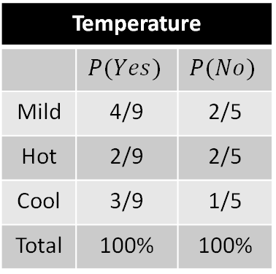
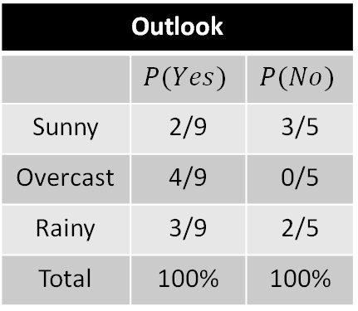
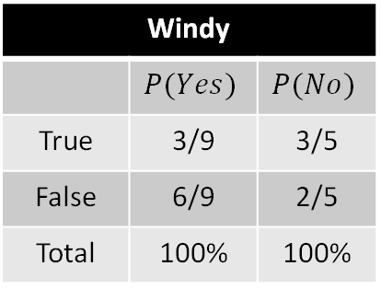
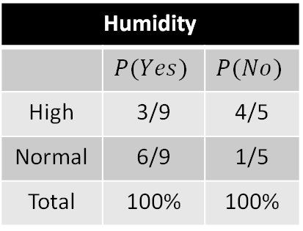
Naïve Bayes Classifier
TID | Outlook | Temperature | Humidity | Windy | Play
1 | Sunny | Hot | High | F | N
2 | Sunny | Hot | High | T | N
3 | Overcast | Hot | High | F | Y
4 | Rainy | Mild | High | F | Y
5 | Rainy | Cool | Normal | F | Y
6 | Rainy | Cool | Normal | T | N
7 | Overcast | Cool | Normal | T | Y
8 | Sunny | Mild | High | F | N
9 | Sunny | Cool | Normal | F | Y
10 | Rainy | Mild | Normal | F | Y
11 | Sunny | Mild | Normal | T | Y
12 | Overcast | Mild | High | T | Y
13 | Overcast | Hot | Normal | F | Y
14 | Rainy | Mild | High | T | N
15 | Sunny | Cool | High | T | ???
We now do something similar with the rest of our features…
Outlook
 | $$P(Yes)$$ | $$P(No)$$
Sunny | 2/9 | 3/5
Overcast | 4/9 | 0/5
Rainy | 3/9 | 2/5
Total | 100% | 100%
Temperature
 | $$P(Yes)$$ | $$P(No)$$
Mild | 4/9 | 2/5
Hot | 2/9 | 2/5
Cool | 3/9 | 1/5
Total | 100% | 100%
Humidity
 | $$P(Yes)$$ | $$P(No)$$
High | 3/9 | 4/5
Normal | 6/9 | 1/5
Total | 100% | 100%
Windy
 | $$P(Yes)$$ | $$P(No)$$
True | 3/9 | 3/5
False | 6/9 | 2/5
Total | 100% | 100%
Play | Play
Yes | 9 | 9/14
No | 5 | 5/14
Total | 14 | 100%

Slide 12
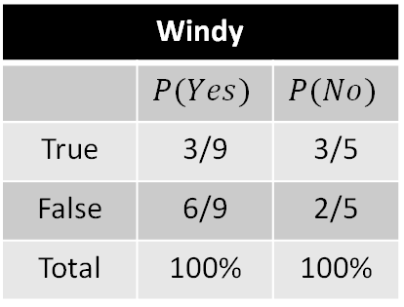
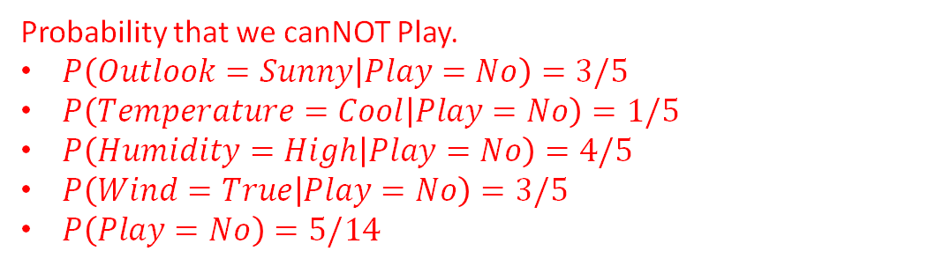
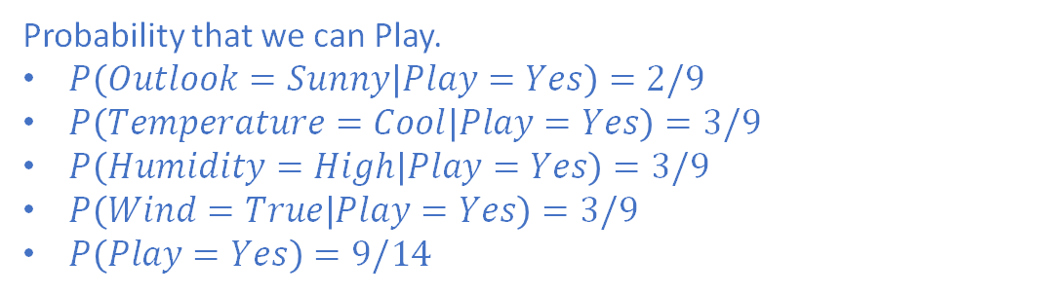
Naïve Bayes Classifier
TID | Outlook | Temperature | Humidity | Windy | Play
15 | Sunny | Cool | High | T | ????
How do we classify this now using these statistics?
Outlook
 | $$P(Yes)$$ | $$P(No)$$
Sunny | 2/9 | 3/5
Overcast | 4/9 | 0/5
Rainy | 3/9 | 2/5
Total | 100% | 100%
Temperature
 | $$P(Yes)$$ | $$P(No)$$
Mild | 4/9 | 2/5
Hot | 2/9 | 2/5
Cool | 3/9 | 1/5
Total | 100% | 100%
Probability that we can Play.
$P\left(Outlook=Sunny | Play=Yes\right)=2/9$
$P\left(Temperature=Cool | Play=Yes\right)=3/9$
$P\left(Humidity=High | Play=Yes\right)=3/9$
$P\left(Wind=True | Play=Yes\right)=3/9$
$P\left(Play=Yes\right)=9/14$
Humidity
 | $$P(Yes)$$ | $$P(No)$$
High | 3/9 | 4/5
Normal | 6/9 | 1/5
Total | 100% | 100%
Windy
 | $$P(Yes)$$ | $$P(No)$$
True | 3/9 | 3/5
False | 6/9 | 2/5
Total | 100% | 100%
Probability that we canNOT Play.
$P\left(Outlook=Sunny | Play=No\right)=3/5$
$P\left(Temperature=Cool | Play=No\right)=1/5$
$P\left(Humidity=High | Play=No\right)=4/5$
$P\left(Wind=True | Play=No\right)=3/5$
$P\left(Play=No\right)=5/14$
Play | Play
Yes | 9 | 9/14
No | 5 | 5/14
Total | 14 | 100%

Slide 13
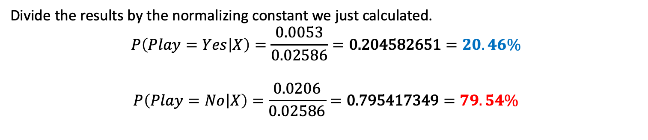

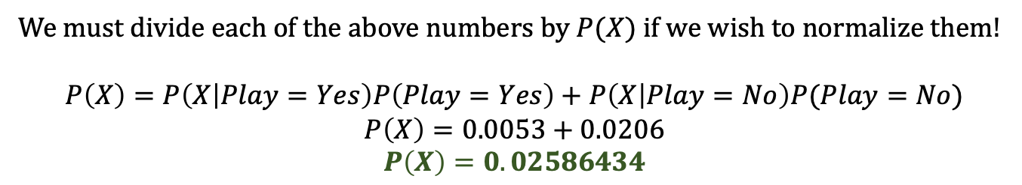
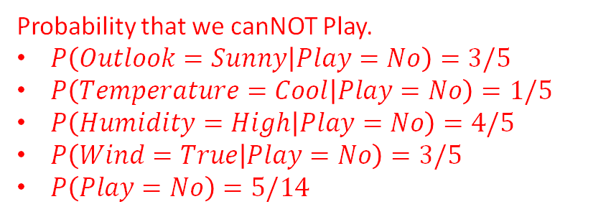
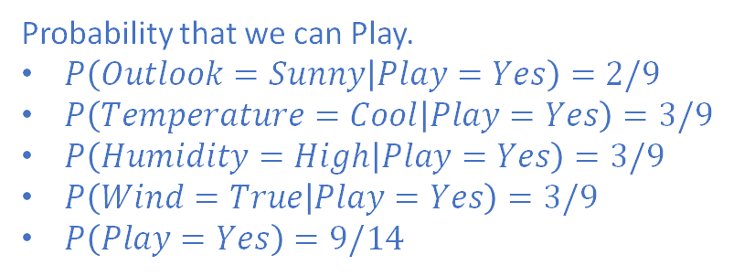
Naïve Bayes Classifier
TID | Outlook | Temperature | Humidity | Windy | Play
15 | Sunny | Cool | High | T | ????
Probability that we can Play.
$P\left(Outlook=Sunny | Play=Yes\right)=2/9$
$P\left(Temperature=Cool | Play=Yes\right)=3/9$
$P\left(Humidity=High | Play=Yes\right)=3/9$
$P\left(Wind=True | Play=Yes\right)=3/9$
$P\left(Play=Yes\right)=9/14$
Probability that we canNOT Play.
$P\left(Outlook=Sunny | Play=No\right)=3/5$
$P\left(Temperature=Cool | Play=No\right)=1/5$
$P\left(Humidity=High | Play=No\right)=4/5$
$P\left(Wind=True | Play=No\right)=3/5$
$P\left(Play=No\right)=5/14$
$$P\left(X | Class\right)P(Class)$$
$$P\left(X | Play=Yes\right)P(Play=Yes)=\left(2/9\right)∗\left(3/9\right)∗\left(3/9\right)∗\left(3/9\right)∗\left(9/14\right)=0.0053$$
$$P\left(X | Play=No\right)P(Play=No)=\left(3/5\right)∗\left(1/5\right)∗\left(4/5\right)∗\left(3/5\right)∗\left(5/14\right)=0.0206$$
We must divide each of the above numbers by $P(X)$ if we wish to normalize them!
$$P\left(X\right)=P\left(X | Play=Yes\right)P\left(Play=Yes\right)+P\left(X | Play=No\right)P(Play=No)$$
$$P\left(X\right)=0.0053+0.0206$$
$$P\left(X\right)=0.02586434$$
Divide the results by the normalizing constant we just calculated.
$$P\left(Play=Yes | X\right)=\frac{0.0053}{0.02586}=\text{0.204582651}=20.46\%$$
$$P\left(Play=No | X\right)=\frac{0.0206}{0.02586}=\text{0.795417349}=79.54\%$$

Slide 14
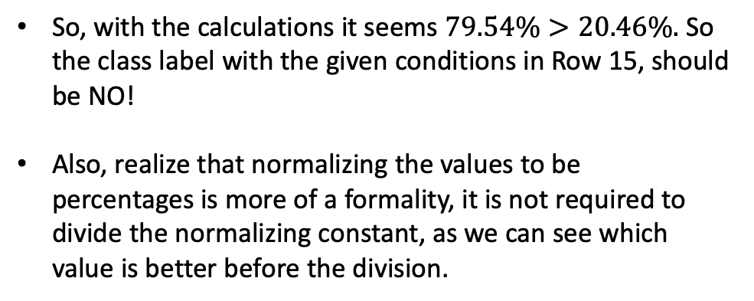
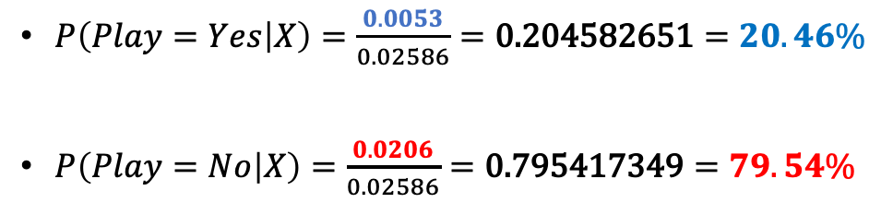
Naïve Bayes Classifier
TID | Outlook | Temperature | Humidity | Windy | Play
1 | Sunny | Hot | High | F | N
2 | Sunny | Hot | High | T | N
3 | Overcast | Hot | High | F | Y
4 | Rainy | Mild | High | F | Y
5 | Rainy | Cool | Normal | F | Y
6 | Rainy | Cool | Normal | T | N
7 | Overcast | Cool | Normal | T | Y
8 | Sunny | Mild | High | F | N
9 | Sunny | Cool | Normal | F | Y
10 | Rainy | Mild | Normal | F | Y
11 | Sunny | Mild | Normal | T | Y
12 | Overcast | Mild | High | T | Y
13 | Overcast | Hot | Normal | F | Y
14 | Rainy | Mild | High | T | N
15 | Sunny | Cool | High | T
$P\left(Play=Yes | X\right)=\frac{0.0053}{0.02586}=\text{0.204582651}=20.46\%$
$P\left(Play=No | X\right)=\frac{0.0206}{0.02586}=\text{0.795417349}=79.54\%$
So, with the calculations it seems $79.54\%>20.46\%.$ So the class label with the given conditions in Row 15, should be NO!
Also, realize that normalizing the values to be percentages is more of a formality, it is not required to divide the normalizing constant, as we can see which value is better before the division.
So what was the Naïve part?...
It is the fact that we take on an assumption that feature values are independent for members of a given class
N
???

Slide 15
TID | Outlook | Temperature | Humidity | Windy | Play
1 | Sunny | Hot | High | F | N
2 | Sunny | Hot | High | T | N
3 | Overcast | Hot | High | F | Y
4 | Rainy | Mild | High | F | Y
5 | Rainy | Cool | Normal | F | Y
6 | Rainy | Cool | Normal | T | N
7 | Overcast | Cool | Normal | T | Y
8 | Sunny | Mild | High | F | N
9 | Sunny | Cool | Normal | F | Y
10 | Rainy | Mild | Normal | F | Y
11 | Sunny | Mild | Normal | T | Y
12 | Overcast | Mild | High | T | Y
13 | Overcast | Hot | Normal | F | Y
14 | Rainy | Mild | High | T | N
15 | Sunny | Cool | High | T | N
16 | Overcast | Mild | Normal | T | ???

Slide 16

Decision Trees (a review)
Tree that allows the classification of some…thing
Visual structure:
Start at root
Each node specifies some attribute
Each branch is a value for that attribute
Leaves represent the classification

Slide 17
Decision Trees (a review)
Tree that allows the classification of some…thing
Logical structure:
Disjunction of conjunctions of constraint
ORing groups of ANDS of constraints
An example:
(A ^ B) V (C ^ D)

Slide 18
Decision Trees
When should we use them?
Discrete values for attribute-value pairs
Output function has discrete value output
Disjunctive descriptions are valid
Training data can have errors
Training data can be missing data
What to watch out for?
Deep trees

Slide 19
Decision Trees
HOW do we create these classifiers?
from sklearn.tree import DecisionTreeClassifier
classifier = DecisionTreeClassifier(**params)
classifier.fit(train_x, train_y)
……Okay, but HOW do we do it?
That code above tells us how to train something using tools
How do we actually create the tree?

Slide 20
ID3/C4.5 Algorithms
ID3 = Iterative Dichotomiser 3
C4.5 = C4.5
C4.5 is more up-to-date version of ID3
C4.5 is more widely used as it is more robust
Ignores missing data
Effective in NLP
Handles continuous data by SETTING THRESHOLDS
Hint hint
Goes back and PRUNES DEEP TREES TO REDUCE DEPTH

Slide 21
ID3
Pseudo-code
Greedy algorithm
Splits the data in the best way first
Simple-to-complex hill-climb through the search space
Starts with an empty tree
Hypothesis gets more complex as the tree builds
Doesn’t always make the globally optimal choice
But how do we determine this step:
A ← The Attribute that best classifies examples

Slide 22

Entropy & Information Gain
Entropy measures the purity of a collection
0 is a “pure” collection
All data falls into the same category
1 is a perfectly distributed collection
Each category as an equal proportion of the values
$Entropy\left(S\right)= \sum_{i=1}^{c}{−p_{i}\log_{2}{(p_{i})}}$
Where $S$ is our collection
And $p_{i}$ is the proportion of $S$ that falls into category $i$

Slide 23

Entropy & Information Gain
Information Gain measures reduction in entropy
Specifically, how entropy is affected by partitioning a set on an attribute
$Gain\left(S, A\right)=Entropy\left(S\right)−\sum_{v∈Values(A)}{\frac{\left|S_{v}\right|}{\left|S\right|}Entropy(S_{v})}$
$Values(A)$ is the set of possible values of $A$
$S_{v}$ is the subset of $S$ where attribute $A$ has a value of $v$
$S_{v}=\left\{s∈S \right| A\left(s\right)=v\}$

Slide 24

Entropy & Information Gain
$$Gain\left(S, A\right)=Entropy\left(S\right)−\sum_{v∈Values(A)}{\frac{\left|S_{v}\right|}{\left|S\right|}Entropy(S_{v})}$$
What is this actually saying?
The attribute where will see the most information gain is one:
Where the set is at some level of disorganization before
And is highly, if not completely, organized after the split

Slide 25
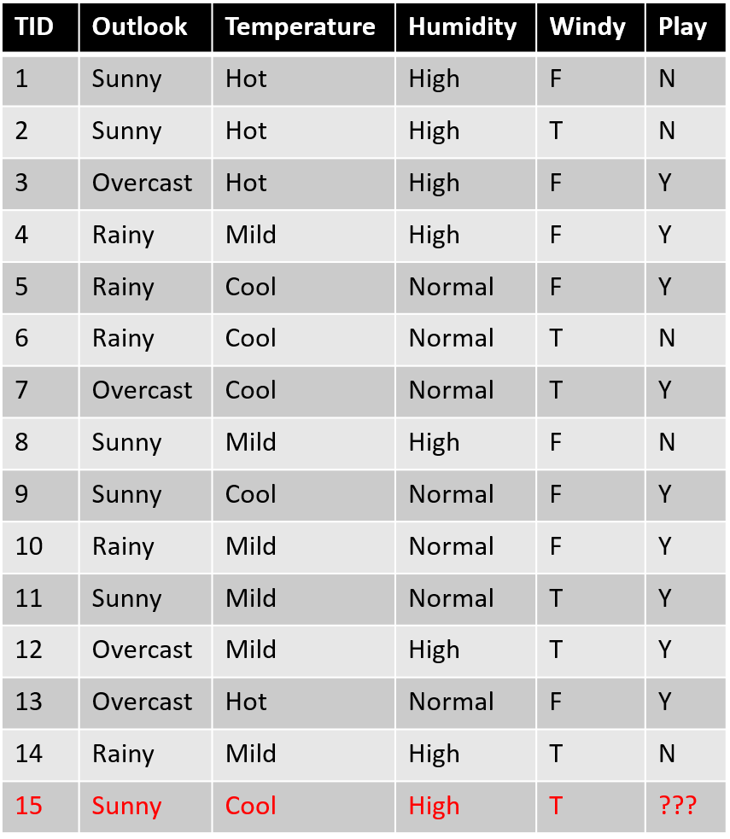
An example!
We have equations for entropy & information gain
ID3 picks the “best” feature first
So what would ID3 pick as their best feature?

Slide 26
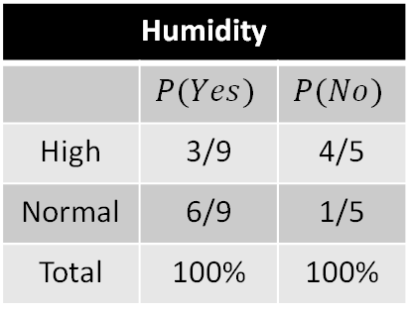
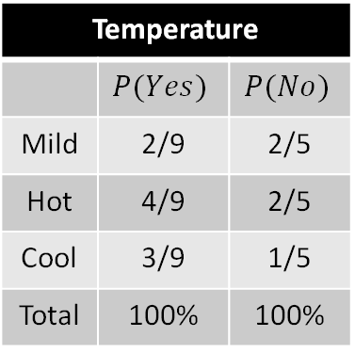
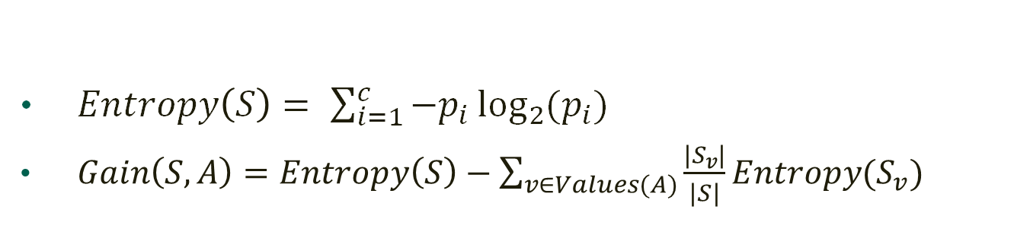
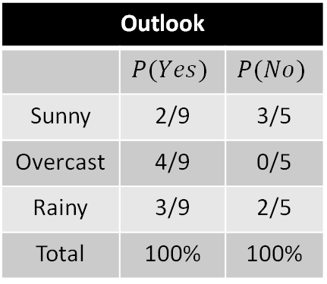
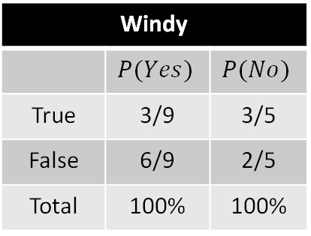
An example!
$Entropy\left(S\right)= \sum_{i=1}^{c}{−p_{i}\log_{2}{(p_{i})}}$
$Gain\left(S, A\right)=Entropy\left(S\right)−\sum_{v∈Values(A)}{\frac{\left|S_{v}\right|}{\left|S\right|}Entropy(S_{v})}$
Outlook
 | $$P(Yes)$$ | $$P(No)$$
Sunny | 2/9 | 3/5
Overcast | 4/9 | 0/5
Rainy | 3/9 | 2/5
Total | 100% | 100%
Temperature
 | $$P(Yes)$$ | $$P(No)$$
Mild | 2/9 | 2/5
Hot | 4/9 | 2/5
Cool | 3/9 | 1/5
Total | 100% | 100%
Humidity
 | $$P(Yes)$$ | $$P(No)$$
High | 3/9 | 4/5
Normal | 6/9 | 1/5
Total | 100% | 100%
Windy
 | $$P(Yes)$$ | $$P(No)$$
True | 3/9 | 3/5
False | 6/9 | 2/5
Total | 100% | 100%

Slide 27
An example!
Results:
Gain(S, Outlook) = 0.2467
Gain(S, Temperature) = 0.0292
Gain(S, Humidity) = 0.1518
Gain(S, Windy) = 0.0481
∴ We should choose outlook first!

Slide 28
Hypothesis
When our tree is generated, we can consider it a hypothesis
“We play outside if it is overcast or if it is sunny and normal humidity or if it is rainy and not windy and normal temperature or if it is rainy and windy and hot and not humid.”
But what if this is not good in general?
We’re back to overfitting.

Slide 29
Overfitting
Our hypothesis is too specific
“We play outside if it is overcast or if it is sunny and normal humidity or if it is rainy and not windy and normal temperature or if it is rainy and windy and hot and not humid.”

Slide 30
Overfitting
Our hypothesis is too specific
“We play outside if it is overcast or if it is sunny and normal humidity or if it is rainy and not windy and normal temperature or if it is rainy and windy and hot and not humid.”
What if this too specific for our data?
What is this represented?
How do fix it?

Slide 31
Solutions to Overfitting
Approach 1: Don’t grow it too deep in the first place
This is the approach forests take
What’s the issue for a traditional decision tree?
How deep is too deep?
Approach 2: Remove the offending branches
Determine mathematically which branches are causing problems
Lop them off
What would you call this?
Post-pruning
Generally the preferred method

Slide 32
Some Post-Pruning Approaches
Reduced-Error Pruning
Each decision node is a candidate
Removed nodes are replaced by the most common leaf node of the subtree rooted at the candidate node
Only removed if the generated subtree would perform no worse than the original tree on the testing data
Coincidental nodes tend to be removed
Iteratively done by the pruning the node which increases accuracy the most
Stops when any pruning decreases accuracy

Slide 33
Some Post-Pruning Approaches
Rule-Based Post-Pruning
Used in C4.5
Train the tree completely, including overfitting
Turn each path into rules from root to leaf
Rules are pruned by removing conditions which increase accuracy
Rules are sorted in order of accuracy
Can be tested on testing or training data
Hypothesis then becomes the rule set, not the tree

Slide 34
Some Post-Pruning Approaches
Rule-Based Post-Pruning
Hypothesis then becomes the rule set, not the tree
Why?
Nodes can be considered and used in different contexts
Traditional pruning removes more leaf nodes than root nodes
Improves readability and use by humans

Slide 35
Alternatives to Information Gain?
What’s the problem with using information gain
What bias does it have?
(Bias is not nefarious, it means what solution(s) does it tend toward)
Biases towards small sets
What if we had a date field?
Tree would likely have a depth of 1 with |Training Set| branches
Do we have alternatives?

Slide 36

Alternatives to Information Gain!
Gini impurity
Measure of probability of randomly incorrectly labeling an element of our data
Labelling is randomly done based on label distribution in the subset
$GI\left(p\right)=\sum_{i=1}^{J}{p_{i}}\sum_{k≠i}{p_{k}}$
Where the set has $J$, $i∈\{1, 2, 3…J\}$, and $p_{i}$ is the proportion of label $i$ within the set

Slide 37

Alternatives to Information Gain!
Gini impurity
Measure of probability of randomly incorrectly labeling an element of our data
Labelling is randomly done based on label distribution in the subset
$GI\left(p\right)=\sum_{i=1}^{J}{p_{i}}\sum_{k≠i}{p_{k}}=\sum_{i=1}^{J}{p_{i}(1−p_{i})}$
Where the set has $J$, $i∈\{1, 2, 3…J\}$, and $p_{i}$ is the proportion of label $i$ within the set

Slide 38

Alternatives to Information Gain!
Gini impurity
Measure of probability of randomly incorrectly labeling an element of our data
Labelling is randomly done based on label distribution in the subset
$GI\left(p\right)=\sum_{i=1}^{J}{p_{i}}\sum_{k≠i}{p_{k}}=\sum_{i=1}^{J}{p_{i}(1−p_{i})}=\sum_{i=1}^{J}{p_{i}−}\sum_{i=1}^{J}{{p_{i}}^{2}}$
Where the set has $J$, $i∈\{1, 2, 3…J\}$, and $p_{i}$ is the proportion of label $i$ within the set

Slide 39

Alternatives to Information Gain!
Gini impurity
Measure of probability of randomly incorrectly labeling an element of our data
Labelling is randomly done based on label distribution in the subset
$GI\left(p\right)=\sum_{i=1}^{J}{p_{i}}\sum_{k≠i}{p_{k}}=\sum_{i=1}^{J}{p_{i}(1−p_{i})}=1−\sum_{i=1}^{J}{{p_{i}}^{2}}$
Where the set has $J$, $i∈\{1, 2, 3…J\}$, and $p_{i}$ is the proportion of label $i$ within the set
A similar metric to Entropy (without all of that $\log_{2}$ nonsense)

Slide 40

Alternatives to Information Gain!
Split Information
Similar to entropy
Takes into account uniformity of the attribute split
$SplitInformation\left(S,A\right)= \sum_{i∈Values(A)}{−\frac{\left|S_{i}\right|}{\left|S\right|}\log_{2}{(\frac{\left|S_{i}\right|}{\left|S\right|})}}$
$Values(A)$ is the set of possible values of $A$
This is just entropy with respect to A instead of our label

Slide 41

Alternatives to Information Gain!
Gain Ratio
Designed to discourage the use of MANY very small sets
$GainRatio\left(S,A\right)=\frac{Gain\left(S,A\right)}{SplitInformation\left(S,A\right)}$
What’s the problem with this?
Distance-Based Measures
Designed to combat the “infinite gain ratio” issue
Define a distance metric between partitions
Each attribute measured on the distance between the partition it creates and a “perfect partition”

Slide 42

Alternatives to Information Gain!
Attributes with Different Costs
Think back to our cancer test Bayesian example
Let’s say we’re making a tree to order our tests for effectiveness
What’s the problem?
Biopsy will be first because it’s the only way to be sure
Biopsies are also surgery, making them expensive, painful, and dangerous
Cost functions can be used to normalize the measure used to select attributes
$\frac{Gain(S,A)}{Cost(A)}$ or $\frac{{Gain}^{2}(S,A)}{Cost(A)}$ or $\frac{GainRatio(S,A)}{Cost(A)}$ or $\frac{{GainRatio}^{2}(S,A)}{Cost(A)}$ or whatevs

Slide 43
Unsupervised Learning
Just like supervised learning, unsupervised learning is a branch of machine learning.
However, unsupervised learning aims to identify patterns in data without knowing the class label of the records it is using.
TID | Outlook | Temperature | Humidity | Windy | Play
1 | Sunny | Hot | High | F | N
2 | Sunny | Hot | High | T | N
3 | Overcast | Hot | High | F | Y
4 | Rainy | Mild | High | F | Y
5 | Rainy | Cool | Normal | F | Y
6 | Rainy | Cool | Normal | T | N
7 | Overcast | Cool | Normal | T | Y
TID | Outlook | Temperature | Humidity | Windy | Play
1 | Sunny | Hot | High | F | ?
2 | Sunny | Hot | High | T | ?
3 | Overcast | Hot | High | F | ?
4 | Rainy | Mild | High | F | ?
5 | Rainy | Cool | Normal | F | ?
6 | Rainy | Cool | Normal | T | ?
7 | Overcast | Cool | Normal | T | ?

Slide 44
Common Clustering Algorithms
Hierarchical clustering: builds a multilevel hierarchy of clusters by creating a cluster tree
k-Means clustering: partitions data into k distinct clusters based on distance to the centroid of a cluster
Gaussian mixture models: models clusters as a mixture of multivariate normal density components
Self-organizing maps: uses neural networks that learn the topology and distribution of the data
Hidden Markov models: uses observed data to recover the sequence of states

Slide 45
K-Means Clustering Definitions
How are we using ‘K’? and what does the ‘Mean’ have anything to do with this?
K = number of clusters
This number is arbitrarily picked, but an optimal number can be found
Mean = average of values (just like any other mean)
We will be using the mean of values in an effort to locate our centroids
Centroid = Center of a given cluster
Cluster = a group of similar things (in our case data points) positioned or occurring closely (Defined by your measure) together.

Slide 46
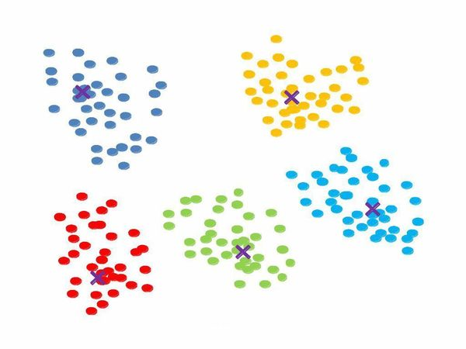
K-Means Clustering Visualization
How can we visualize all of this?
The different colored dots represent the different clusters that we discovered given K = 5.
The X’s would be the centroid of the cluster it is in.

Slide 47
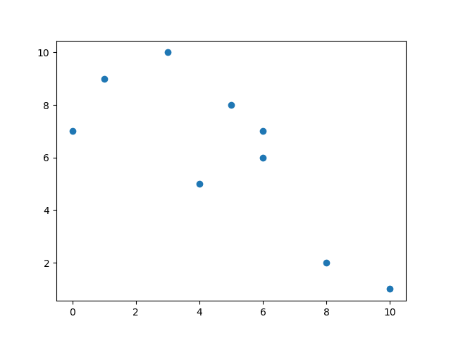
K-Means Clustering Hands-On Example
Let’s get hands on with an example we can work through.
Let’s say we have the data on the right
Each data point represents a point on a graph.
If we were to graph these points it would look something like the following
Data Point | X-Axis | Y-Axis
P1 | 5 | 8
P2 | 4 | 5
P3 | 0 | 7
P4 | 6 | 6
P5 | 3 | 10
P6 | 1 | 9
P7 | 10 | 1
P8 | 8 | 2
P9 | 6 | 7

Slide 48
K-Means Clustering Hands-On Example
What are the steps we would use to apply the K-Means Clustering Algorithm?
1st: Determine the number of clusters arbitrarily.
2nd: Randomly place the K clusters (Preferably farther apart).
3rd: Iterate to calculate which data points are a member of each cluster.
4th: Recalculate the center of the clusters (Recalculate the centroid).
5th: Repeat steps 3 & 4 until the centroids converge.

Slide 49
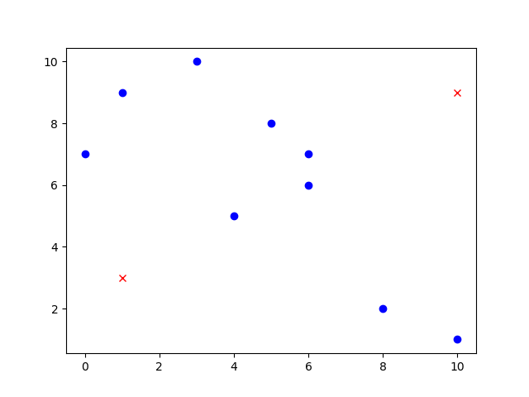
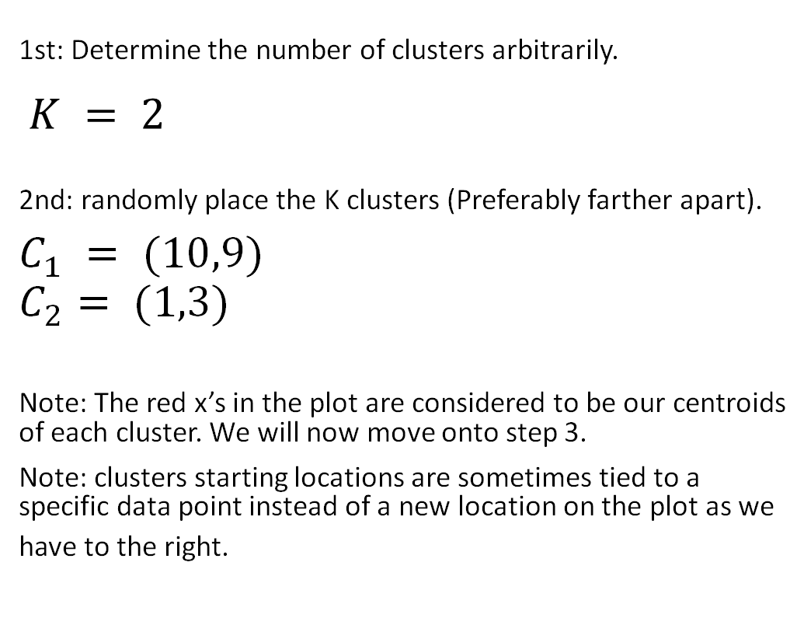
K-Means Clustering Hands-On Example
1st: Determine the number of clusters arbitrarily.
$K = 2$
2nd: randomly place the K clusters (Preferably farther apart).
$$C_{1} = (10,9)$$
$$C_{2}= (1,3)$$
Note: The red x’s in the plot are considered to be our centroids of each cluster. We will now move onto step 3.
Note: clusters starting locations are sometimes tied to a specific data point instead of a new location on the plot as we have to the right.

Slide 50

K-Means Clustering Hands-On Example
3rd: Iterate to calculate which data points are a member of each cluster.
For our distance we will use Euclidean Distance
^{for 2D space.}
Data Point | X-Axis | Y-Axis | Distance C1 (10,9) | Distance C2 (1,3)
P1 | 5 | 8 | 5.099019514 | 6.403124237
P2 | 4 | 5 | 7.211102551 | 3.605551275
P3 | 0 | 7 | 10.19803903 | 4.123105626
P4 | 6 | 6 | 5 | 5.830951895
P5 | 3 | 10 | 7.071067812 | 7.280109889
P6 | 1 | 9 | 9 | 6
P7 | 10 | 1 | 8 | 9.219544457
P8 | 8 | 2 | 7.280109889 | 7.071067812
P9 | 6 | 7 | 4.472135955 | 6.403124237
$$Distance= \sqrt{{\left(x_{2}−x_{1}\right)}^{2}+{\left(y_{2}−y_{1}\right)}^{2}}$$

Slide 51
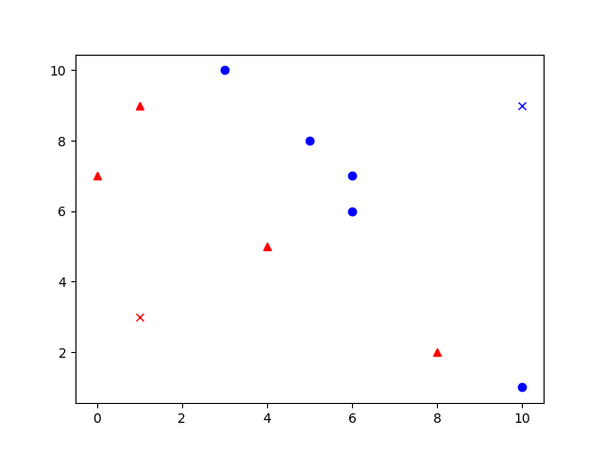
K-Means Clustering Hands-On Example
3rd: Iterate to calculate which data points are a member of each cluster.
By analyzing the table we created on the previous slide, we see the values in red indicate that Px is a member of that cluster.
From this we get the new plot shown to the right
^{NOTE:}
The centroids are still the X’s
The blue circles are in cluster 1
The red triangles are in cluster 2
Data Point | X-Axis | Y-Axis | Distance C1 (10,9) | Distance C2 (1,3)
P1 | 5 | 8 | 5.099019514 | 6.403124237
P2 | 4 | 5 | 7.211102551 | 3.605551275
P3 | 0 | 7 | 10.19803903 | 4.123105626
P4 | 6 | 6 | 5 | 5.830951895
P5 | 3 | 10 | 7.071067812 | 7.280109889
P6 | 1 | 9 | 9 | 6
P7 | 10 | 1 | 8 | 9.219544457
P8 | 8 | 2 | 7.280109889 | 7.071067812
P9 | 6 | 7 | 4.472135955 | 6.403124237

Slide 52
K-Means Clustering Hands-On Example
Data Point | X-Axis | Y-Axis | Distance C2 (1,3)
P2 | 4 | 5 | 3.605551275
P3 | 0 | 7 | 4.123105626
P6 | 1 | 9 | 6
P8 | 8 | 2 | 7.071067812
Mean | 3.25 | 5.75
4th: Recalculate the center of the clusters (Recalculate the centroid).
^{But, how?}
This is where our means come into play.
These new means of x-values and y-values of each cluster
become the ordered pair describing where the new centroids
are located based on membership
Data Point | X-Axis | Y-Axis | Distance C1 (10,9)
P1 | 5 | 8 | 5.099019514
P4 | 6 | 6 | 5
P5 | 3 | 10 | 7.071067812
P7 | 10 | 1 | 8
P9 | 6 | 7 | 4.472135955
Mean | 6 | 6.4

Slide 53
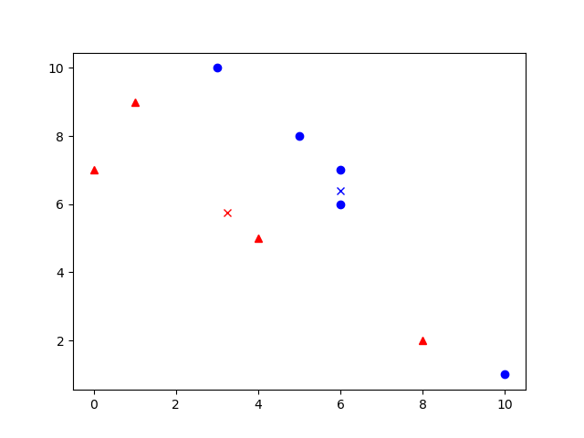
K-Means Clustering Hands-On Example
4th: Recalculate the center of the clusters (Recalculate the centroid).
^{How does this change our plot?}

Slide 54
K-Means Clustering Hands-On Example
Where do you think the centroids will converge
if you continue with the second, third, fourth iteration?
5th: Repeat steps 3 & 4 until the centroids converge.
Now that we have seen how to plot data and how to
shift around the centroid, we can continue until
^{convergence.}
^{What is convergence?}
^{Formally defined:}
^{tend to meet at a point.}
^{Informally defined:}
We know we have reached convergence, when
the centroids no longer move or when none
of the data points change clusters anymore.
?

Slide 55
How to find K?
When clustering using K-Means, it becomes increasingly important to find the best K value.
We said before that it is arbitrarily chosen, but what are some ways to find the best K?

Slide 56
Elbow Method

Slide 57
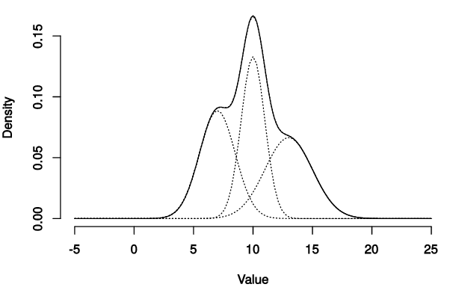
Finding K using Mean Shift Algorithm
Before defining Mean Shift Algorithm, there are some terms we need to know…
Parametric vs Non-parametric
Parametric: Assumptions about the underlying distribution (or parameters) are made.
Non-Parametric: No assumptions about the underlying distribution (or parameters) are made.
Probability Density Function:
A function of a continuous random variable, whose integral across an interval gives the probability that the value of the variable lies within the same interval.
Mean Shift Algorithm:
A non-parametric algorithm which considers the entire feature space as a probability density function. In which its goal is to identify the locations of centroids by using the probability density function and place the centroids at the local maxima of the underlying distribution.
If there are K peaks in the distribution, then there should be K clusters in our data.

Slide 58
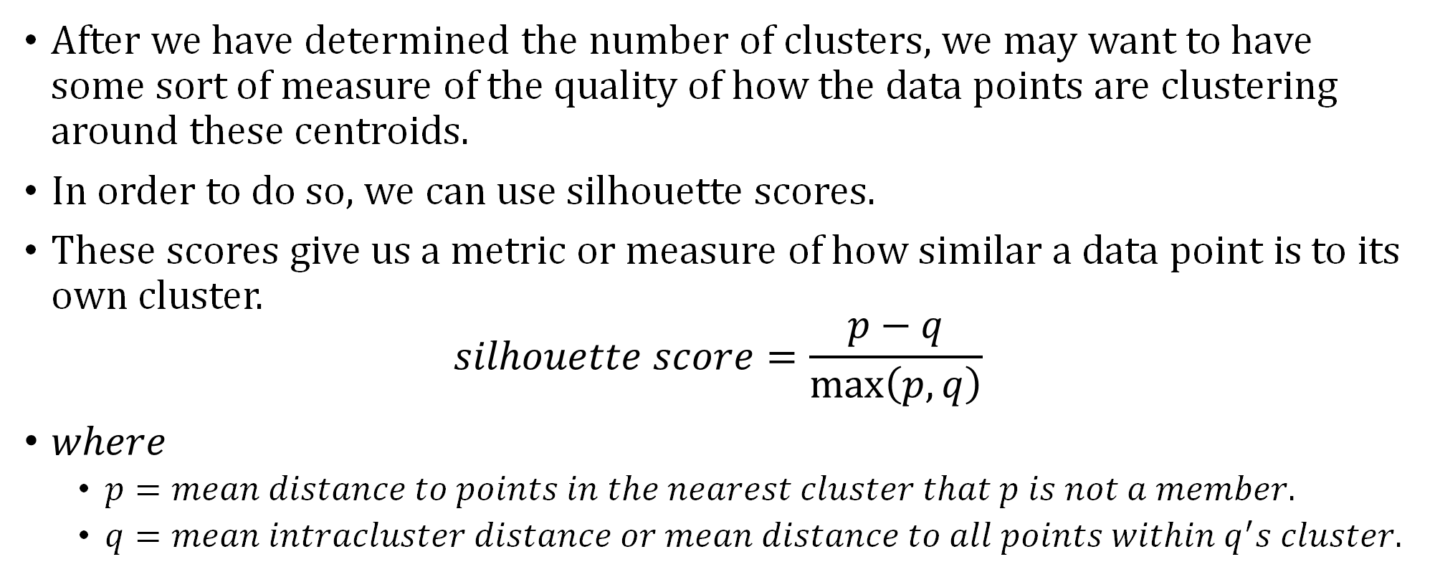
Using Silhouette Scores to Estimate Quality
After we have determined the number of clusters, we may want to have some sort of measure of the quality of how the data points are clustering around these centroids.
In order to do so, we can use silhouette scores.
These scores give us a metric or measure of how similar a data point is to its own cluster.
$$silhouette score=\frac{p−q}{\max\left(p,q\right)}$$
$where$
$p=mean distance to points in the nearest cluster that p is not a member.$
$q=mean intracluster distance or mean distance to all points within q^{′}s cluster.$

